Slide 1
Norman Lab Guide to Starting Data Analysis
Kelly Faig

Slide 2
Study 1: Methods
Kelly’s Butyric Acid Accents Study
Control
Experimental
Speaker Ratings
IAPS Ratings
n = 59 participants
Baseline
Speaker Ratings
IAPS Ratings
Questionnaires
Smell Rating
Debrief
Resting PNS Collection
Experimental
Speaker Ratings
Odor
Task-specific PNS Collection
Task Specific PNS Collection

Slide 3
Individual differences variables:
CESD
UCLA Loneliness
Disgust sensitivity
Perceived Vulnerability to disease
Stai state/trait anxiety
Gender
Age
Ethnicity
Marital Status
Sexual Orientation
Birth Order
Self and parental education
Native and fluent languages
Overall health status
Medications
Alcohol and Drug use
Dietary restrictions
Health problem history
Sensory impairment
Menstrual cycle info
Accents
Foreignness
Foreignness RT
Similarity
Similarity RT
Warmth
Warmth RT
Pleasantness
Pleasantness RT
Competence
Competence RT
Duration (3,6,9s)
IAPS: disgust, neutral, negative, positive, social/nonsocial
Positivity
Negativity
Emotional arousal
Evaluative space RT
Emotional arousal RT
Autonomic measures
HRV
HR
RESP
PEP
Stroke volume
Cardiac output
Smell Rating

Slide 4
Identifying “first tier” questions
Does disgust alter perception of accented speakers through the behavioral immune system?
Does the autonomic nervous system play a role?

Slide 5
Individual differences variables:
CESD
UCLA Loneliness
Disgust sensitivity
Perceived Vulnerability to disease
Stai state/trait anxiety
Gender
Age
Ethnicity
Marital Status
Sexual Orientation
Birth Order
Self and parental education
Native and fluent languages
Overall health status
Medications
Alcohol and Drug use
Dietary restrictions
Health problem history
Sensory impairment
Menstrual cycle info
Accents
Foreignness
Foreignness RT
Similarity
Similarity RT
Warmth
Warmth RT
Pleasantness
Pleasantness RT
Competence
Competence RT
Duration (3,6,9s)
IAPS: disgust, neutral, negative, positive, social/nonsocial
Positivity
Negativity
Emotional arousal
Evaluative space RT
Emotional arousal RT
Autonomic measures
HRV
HR
RESP
PEP
Stroke volume
Cardiac output
Smell Rating
Notes:
Even though you have first tier, you will analyze all of it

Slide 6
Individual differences variables:
CESD
UCLA Loneliness
Disgust sensitivity
Perceived Vulnerability to disease
Stai state/trait anxiety
Gender
Age
Ethnicity
Marital Status
Sexual Orientation
Birth Order
Self and parental education
Native and fluent languages
Overall health status
Medications
Alcohol and Drug use
Dietary restrictions
Health problem history
Sensory impairment
Menstrual cycle info
Accents
Foreignness
Foreignness RT
Similarity
Similarity RT
Warmth
Warmth RT
Pleasantness
Pleasantness RT
Competence
Competence RT
Duration (3,6,9s)
IAPS: disgust, neutral, negative, positive, social/nonsocial
Positivity
Negativity
Emotional arousal
Evaluative space RT
Emotional arousal RT
Autonomic measures
HRV
HR
RESP
PEP
Stroke volume
Cardiac output
Smell Rating
Notes:
Important controls

Slide 7
Individual differences variables:
CESD
UCLA Loneliness
Disgust sensitivity
Perceived Vulnerability to disease
Stai state/trait anxiety
Gender
Age
Ethnicity
Marital Status
Sexual Orientation
Birth Order
Self and parental education
Native and fluent languages
Overall health status
Medications
Alcohol and Drug use
Dietary restrictions
Health problem history
Sensory impairment
Menstrual cycle info
Accents
Foreignness
Foreignness RT
Similarity
Similarity RT
Warmth
Warmth RT
Pleasantness
Pleasantness RT
Competence
Competence RT
Duration (3,6,9s)
IAPS: disgust, neutral, negative, positive, social/nonsocial
Positivity
Negativity
Emotional arousal
Evaluative space RT
Emotional arousal RT
Autonomic measures
HRV
HR
RESP
PEP
Stroke volume
Cardiac output
Smell Rating
Notes:
Room for collaboration

Slide 8
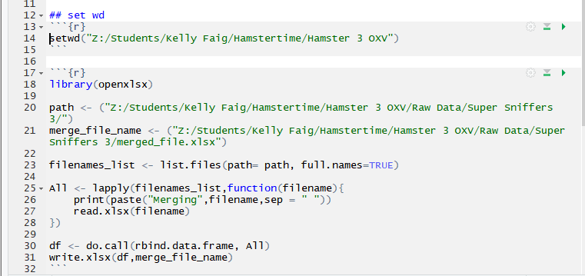
Compiling data
e-merge
HRV compiler
Excel/ R compiling

Slide 9
Long format for R

Slide 10
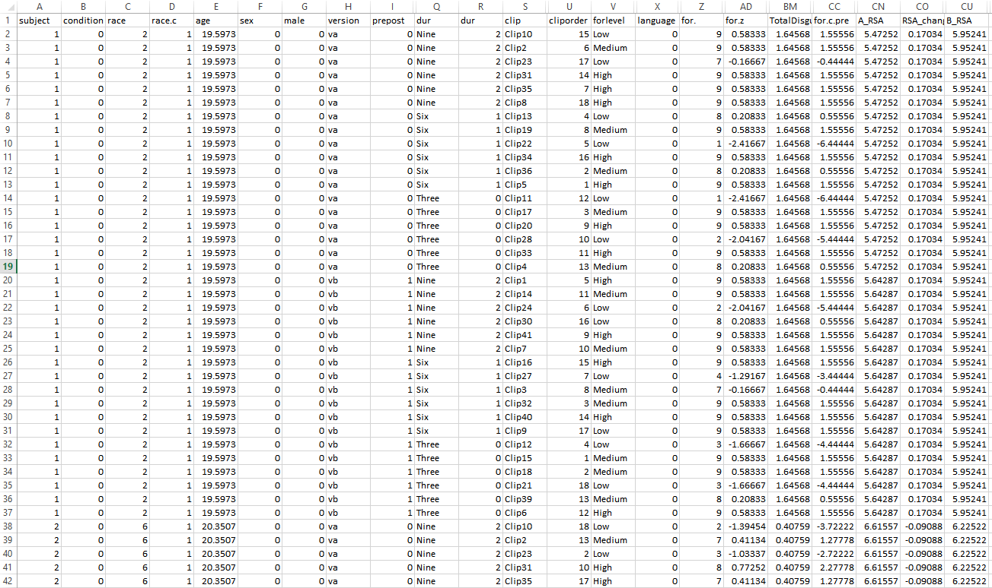

Slide 11
Outlier checks
For all variables
within subject and between subject
Is each foreignness score within 3 SD +/- mean foreignness per person?
Is each foreignness score within 3 SD +/- mean foreignness across whole sample?
Save spreadsheets with and without outliers in case you need to put them back in

Slide 13
Descriptives
Age, gender, ethnicity/race, native language PER GROUP
Check if groups are even, otherwise will likely need to control for differences in models
“Sixty-three adults between the ages of 18 and 26 (mean= 21.22, sd= 1.85, no significant difference between conditions t56= 1.087, p= 0.282) participated in exchange for cash or course credit. 3 were excluded (n=1 incomplete data, n=1 outlier in smell rating manipulation check, n=1 outlier for depression), therefore 59 participants were used in analyses ( n= 43 female, n= 16 male). Due to uneven groups, sex added as a covariate throughout analyses. Native languages varied in this sample, with n=48 being native english speakers and n=11 having other languages as their primary language. The non native english speakers were equally spread between smell and control conditions (n=5 control, n=6 smell). Language will also be added as a covariate throughout analyses.”

Slide 14
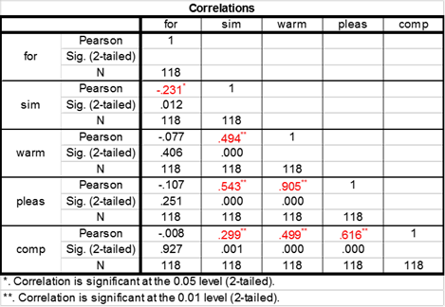
Correlation Matrices
Accent Rating Correlation Matrix
For IAPS data, accents data, questionnaire data, physio data
Notes:
Confirm that variables that are related to one another should be related

Slide 15
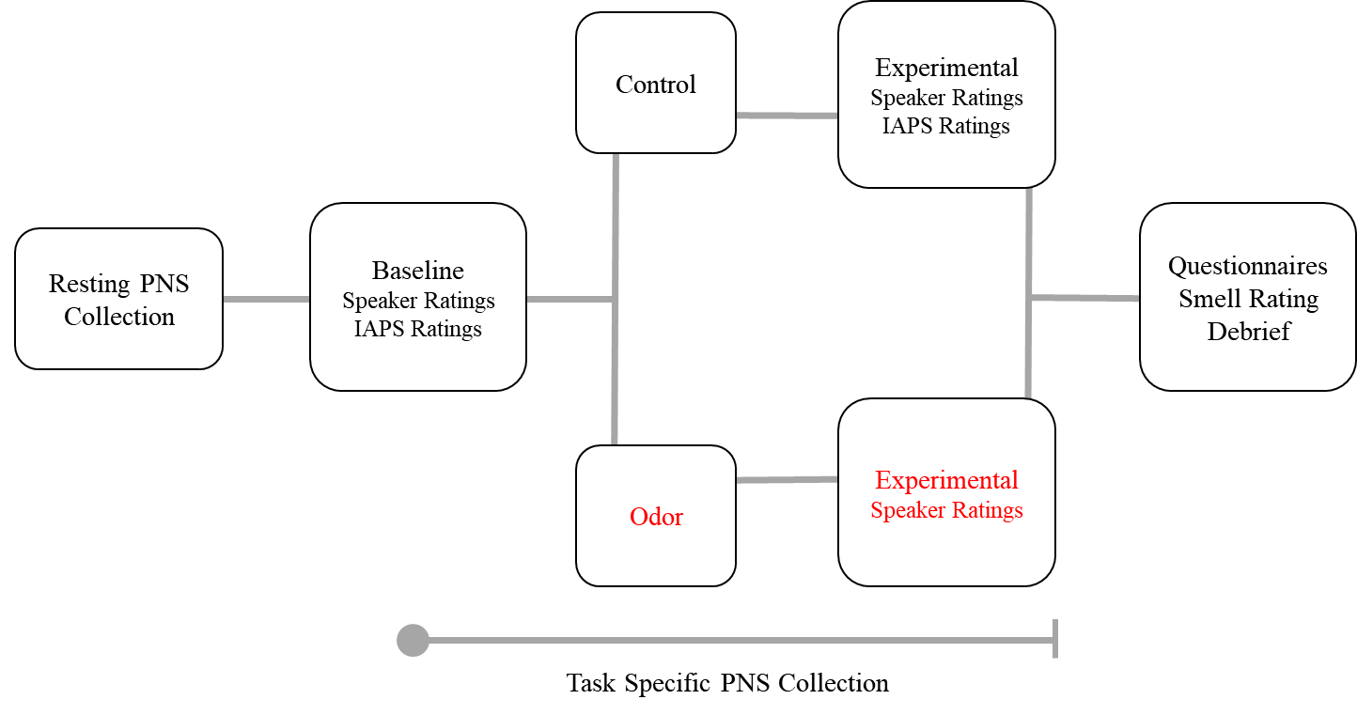
Manipulation checks
Usually t-tests
Are control and smell groups different at baseline?
All accents, IAPS, physio variables
Was smell manipulation actually smelly?

Slide 16
Manipulation checks
Usually t-tests
Are control and smell groups different at baseline?
All accents, IAPS, physio variables
Was smell manipulation actually smelly?

Slide 17
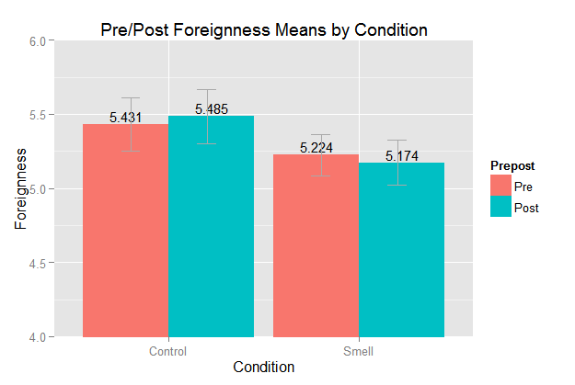
Primary models
Does foreignness change between conditions from pre to post- smell?
ANOVAs
Regressions

Slide 18
Dummy coding:
Turning categorical variables into linear predictors
Ex. Does condition predict change in foreignness?
Can ask if 2 types are different from one another (control vs. smell)
Can ask if foreignness changes as smell increases (control, smell → 0,1)
- Model reads this as change in quality (ex. Foreignness) with each increase ^
Notes:
Contrast coding

Slide 19
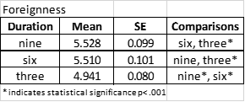
Secondary models
Does duration of speakers clip influence foreignness change between conditions from pre to post- smell?
ANOVAS: Foreignness ~ clip duration * prepost * condition (R ez or afex packages)
Does duration of accent clip affect foreignness ratings? (for~dur)
Yes. (F_{2,116}=39.432,, p<.001)
Does it interact with prepost? (for~dur * prepost)
No. (F_{2,116}=2.304, p=.104)
Does it interact with condition? (for~dur * condition)
No. (F_{2,114}= 0.357, p=.701)
Does adding sex and/or language covariates significantly change the model?
No.

Slide 20
Dummy coding:
Turning categorical variables into linear predictors
Ex. Does duration of speaker clip influence perception?
Can ask if 3 types are different from one another (three vs. six
three vs. nine
six vs. nine)
Can ask if perception changes as duration increases (three, six, nine → 0,1,2)
- Model reads this as change in quality (ex. Foreignness) with each increase ^
Notes:
Contrast coding

Slide 22
Project tasks
Kelly Faig

Slide 23
Accents Disgust Study:
Foreign speaker ratings
IAPS image ratings (CN data)
Vaccine Study:
Foreign speaker ratings
IAPS image ratings
Projective personal space
Emotional stroop
Public goods competition game
Pictures of participants
Cyberball Study:
Cyberball
Emotional stroop
Sentences rating task
TAP reactive aggression paradigm
Liz Fertility study:
Foreign speaker ratings
Picture categorization
Eye tracking face perception
Dot probe task
Kasey Study:
Social vs. physical stress
Time perception and reproduction
Interoception
Political Accents:
Foreign speaker ratings
Political beliefs
Vaccine picture ratings
Hamster studies
Pathogen avoidance of m/f LPS odors
Seasonal modulation of m/f LPS, PolyIC odors
OVX estradiol modulation of m LPS, PolyIC odors
Gallo Stereotype Threat
Memory performance in older compared to young adults
Keysar Disgust in second language
Imagery heavy vs. regular sentence ratings
Auditory vs. reading sentences
Notes:
Karen and Stephanie

